Slide 1



Slide 2

FriktionXKash
Your Trust, Our Cash
Hackathon
July 2023

Slide 3
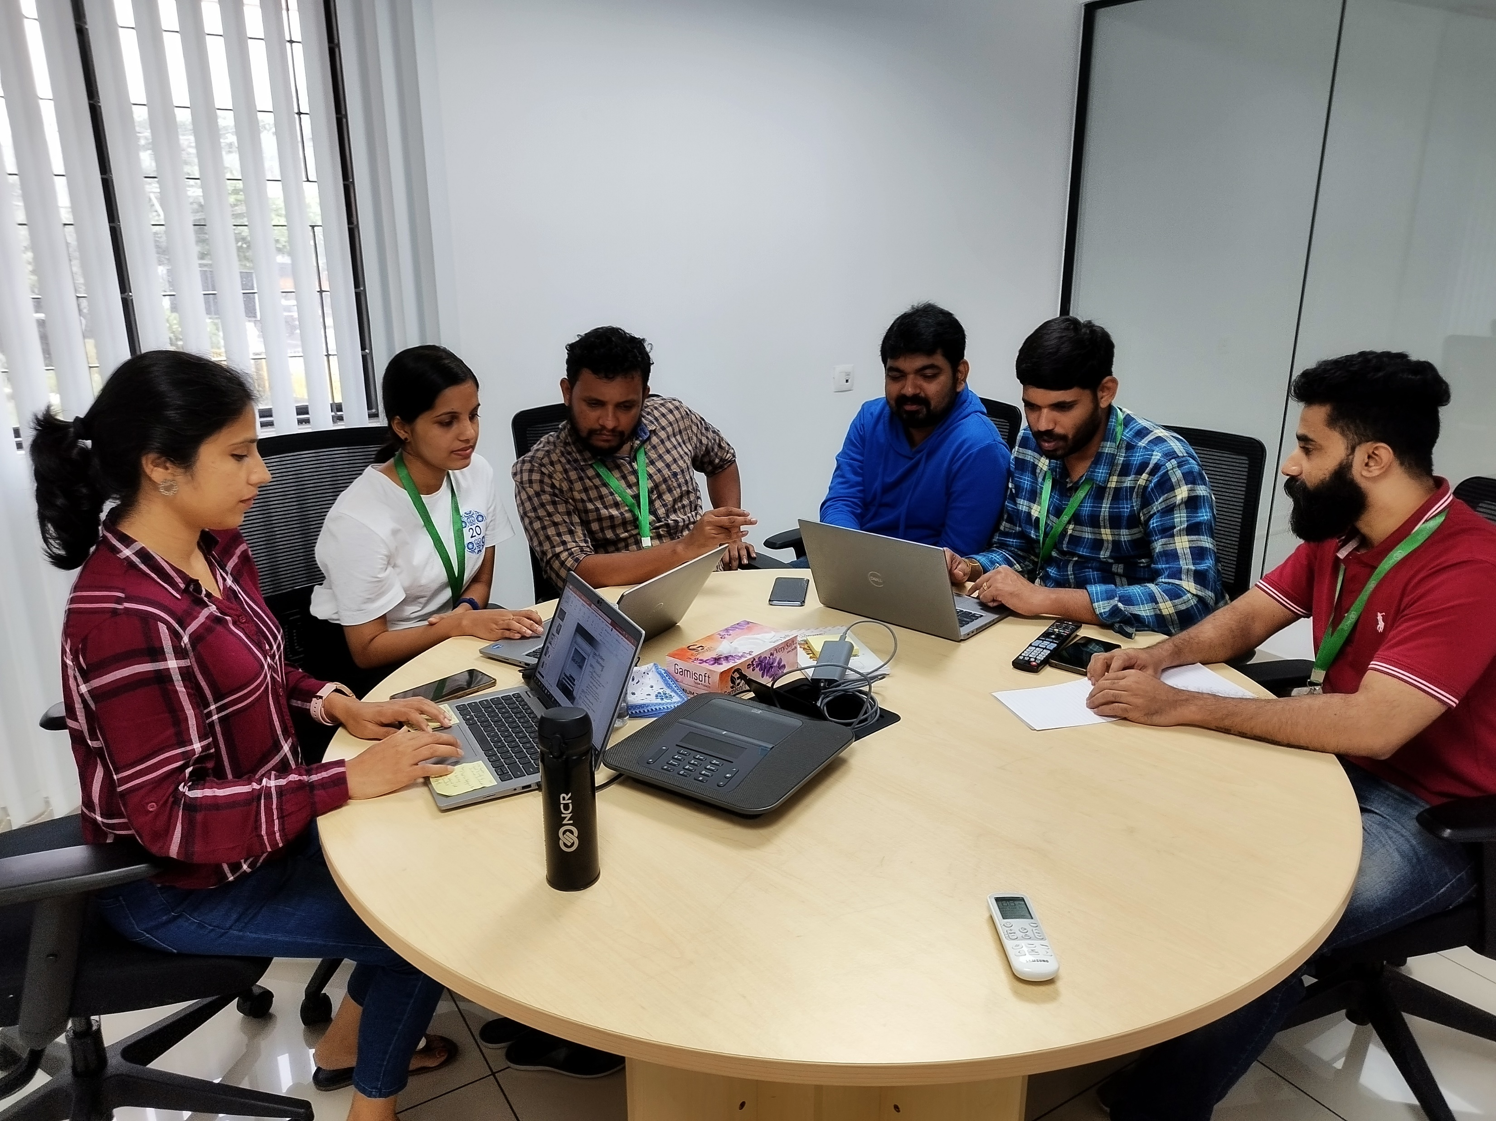

Team profile

Slide 4
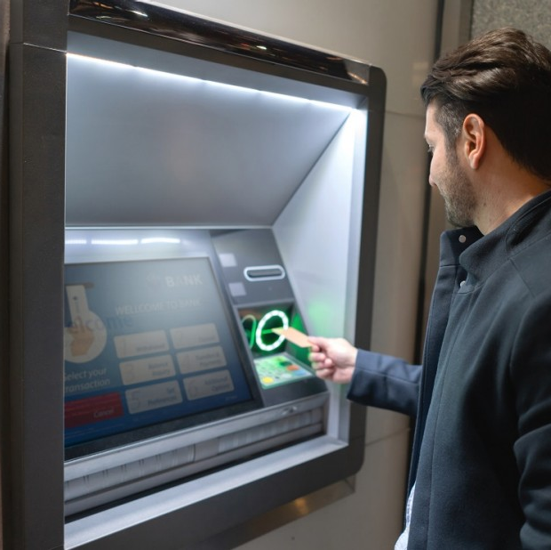

Introduction
This project is aimed at making cash management and movement frictionless between NCR, our ATMs and our customers.

Slide 5
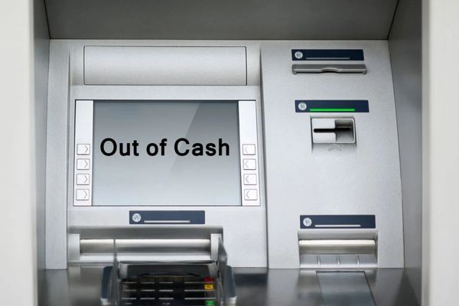
Problem Statement
ATM Out of Cash:
In most cases, customers are unable to withdraw cash when needed.
Out of Cash Penalty:
If the ATMs are out of cash for a certain time period, the merchants end up paying uncalled penalty for such issues.
Realtime Monitoring:
Currently , cash suppliers are unaware of the ATM real-time status.
Bank Reputation:
The financial institution’s reputation will be under jeopardy.

Slide 6
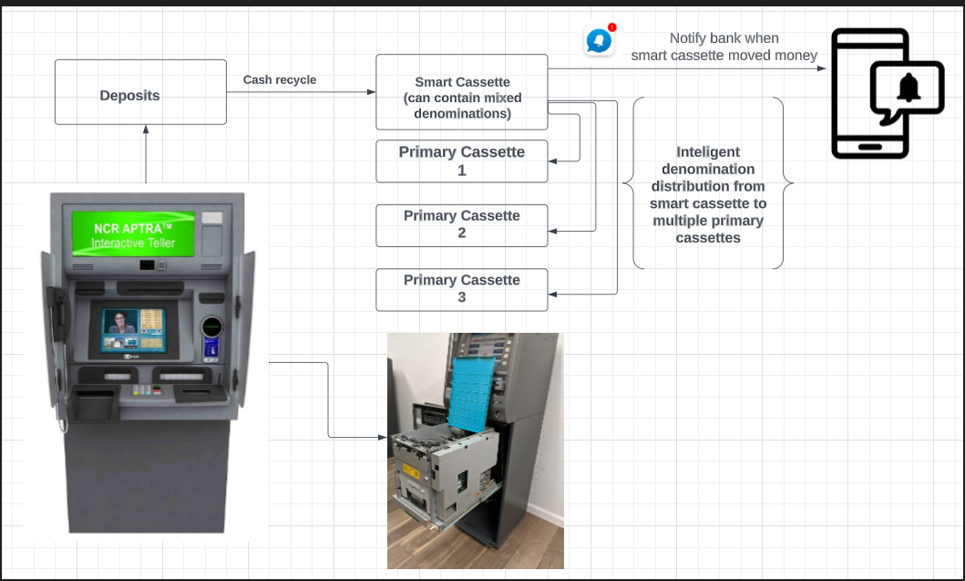
Solution

Slide 7
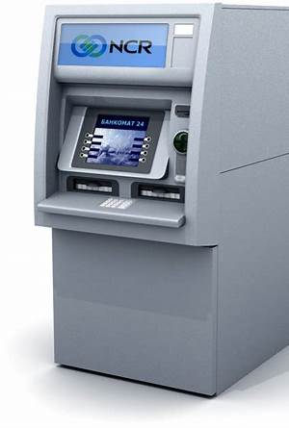
Highlights of FriktionXKash
Cash is always available.
Primary Cassette and Smart Cassette segregation.
Smart Cassette to never run out of cash.
Deposit enabled ATMs to move the deposited cash into the Smart cassette.
High Volume ATM transactions made easy.
Enhanced customer experience.
Reduce their operational costs and capital expenditure.
Deposit Recycle

Slide 8
Conclusion
Customer Retention
Customer Satisfaction
Bank Reputation

Slide 9
Thank you

